Slide 1
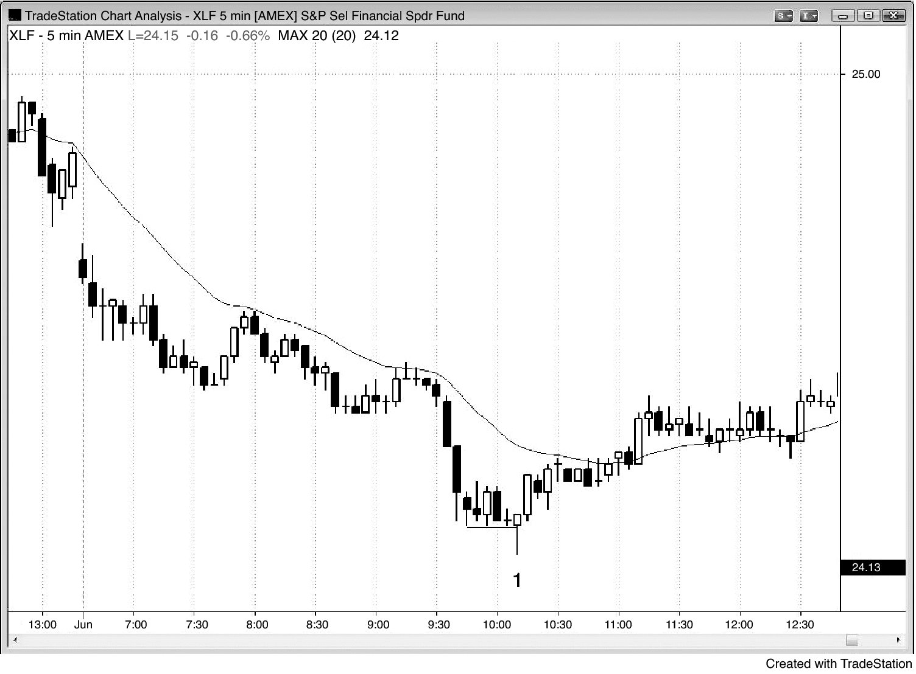
FIGURE 7.1 Final Flag Reversal

Slide 2
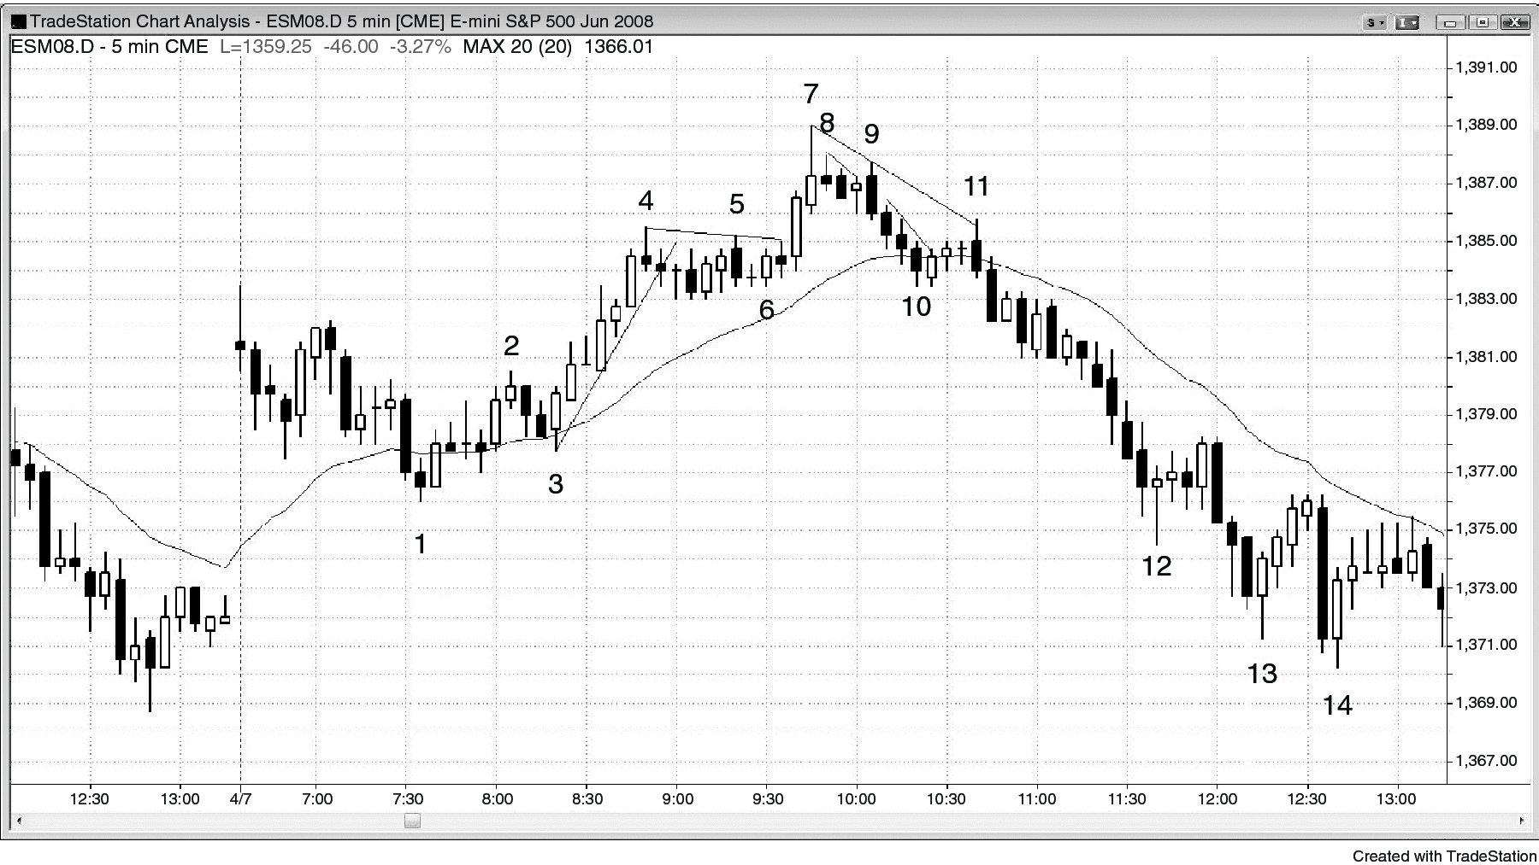
FIGURE 7.2 Tight Trading Range as a Final Flag

Slide 3
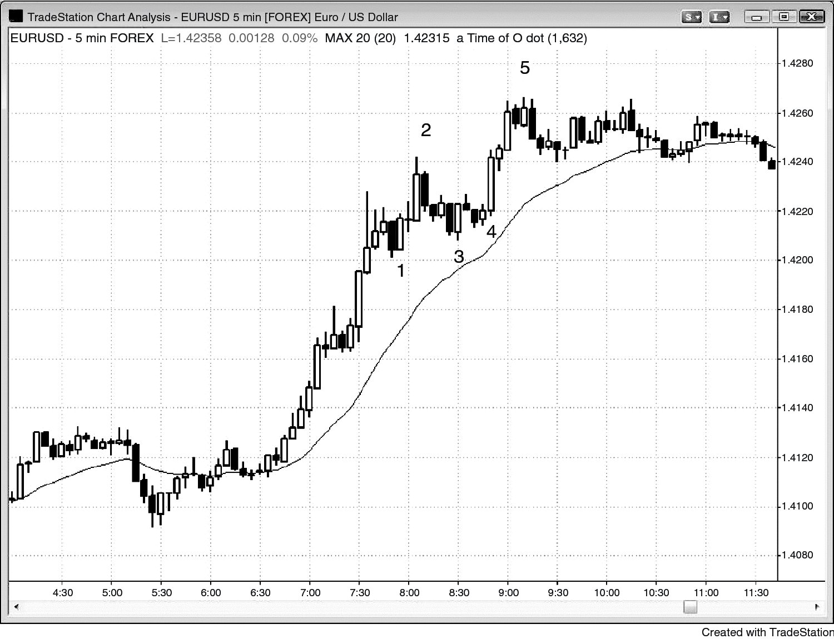
FIGURE 7.3 Triangle as a Final Flag

Slide 4
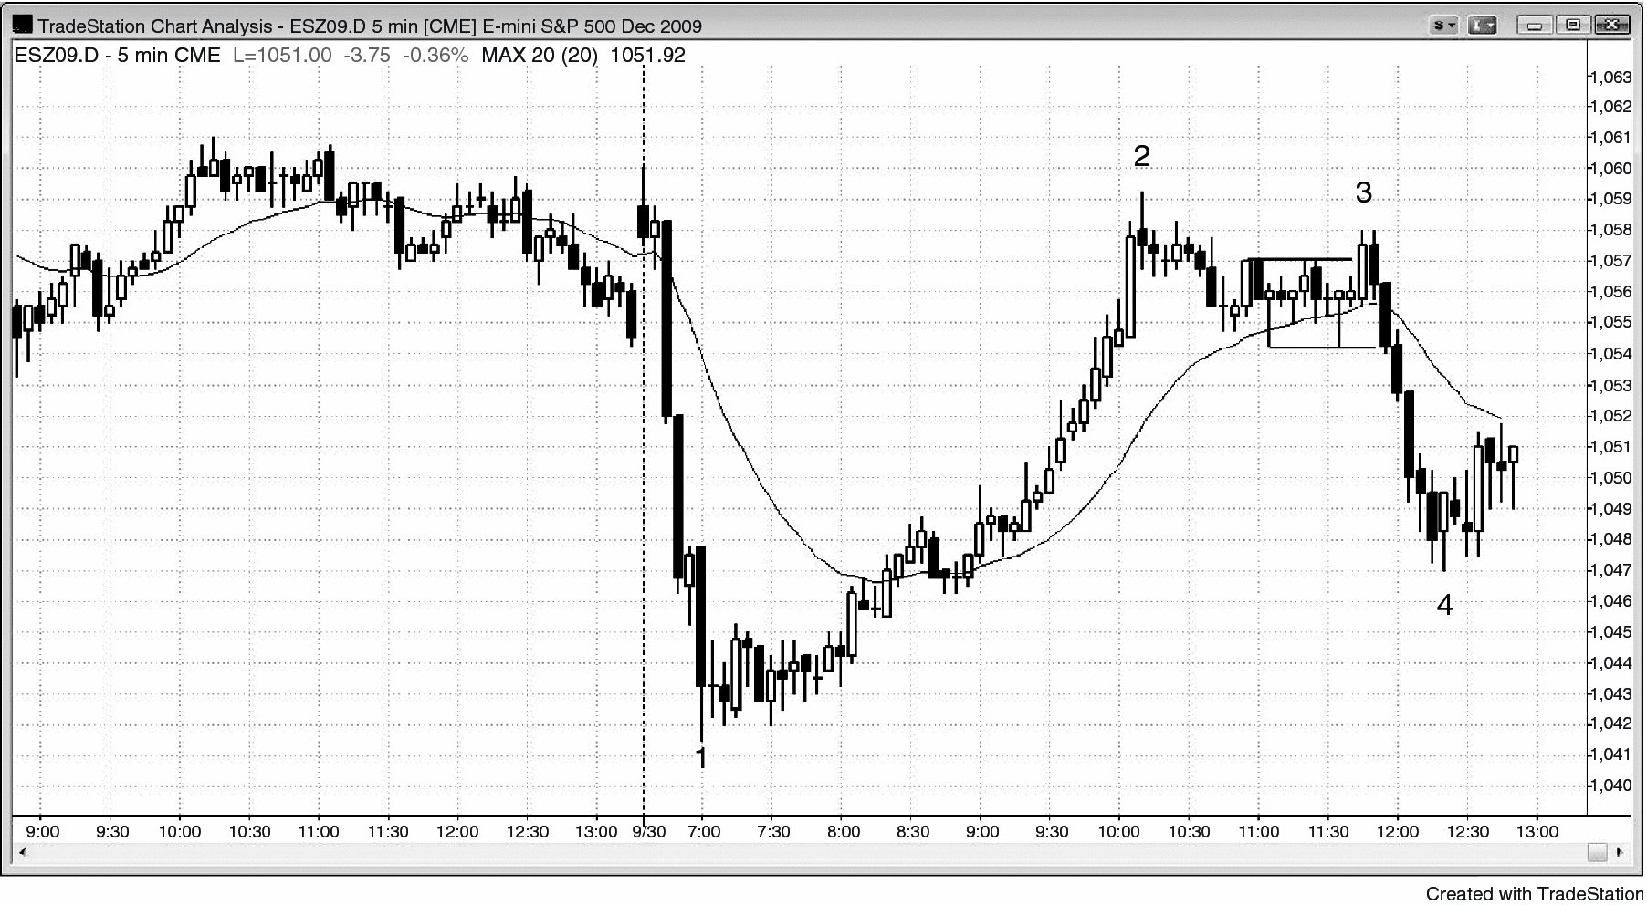
FIGURE 7.4 Final Flag, Then a Lower High

Slide 5
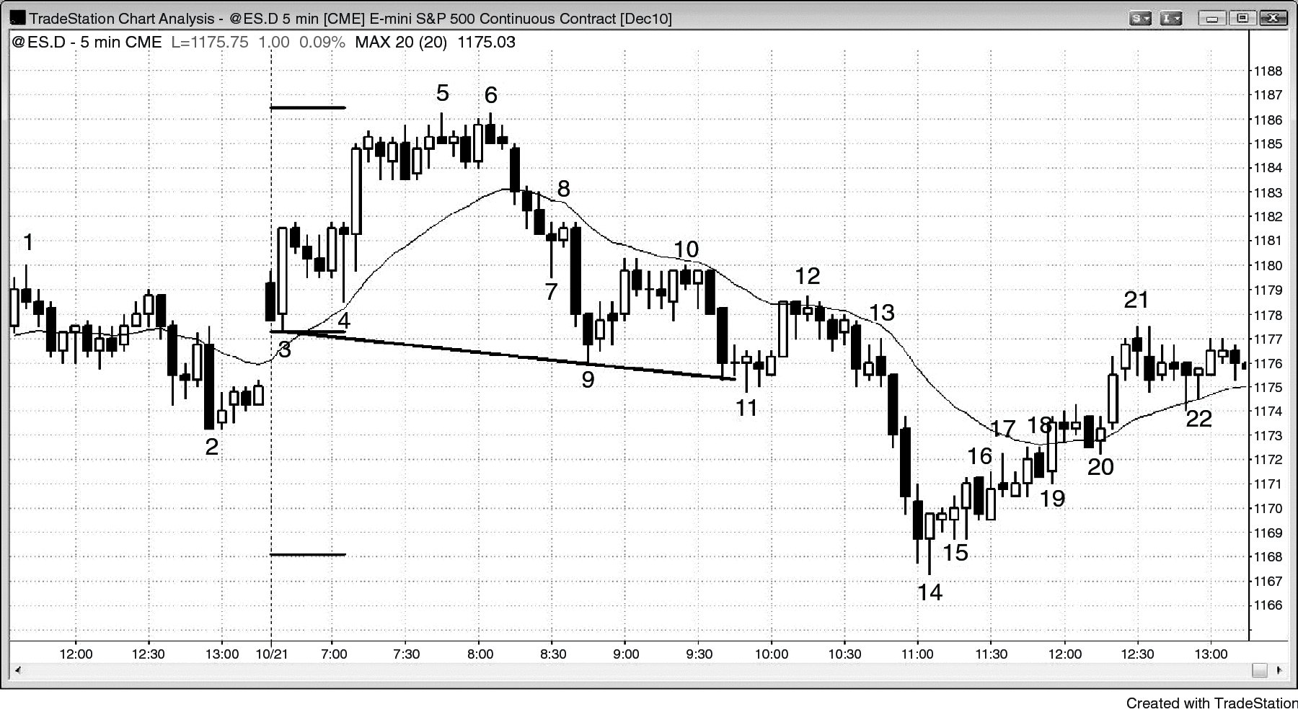
FIGURE 7.5 Final Flags Sometimes Reverse without First Breaking Out

Slide 6
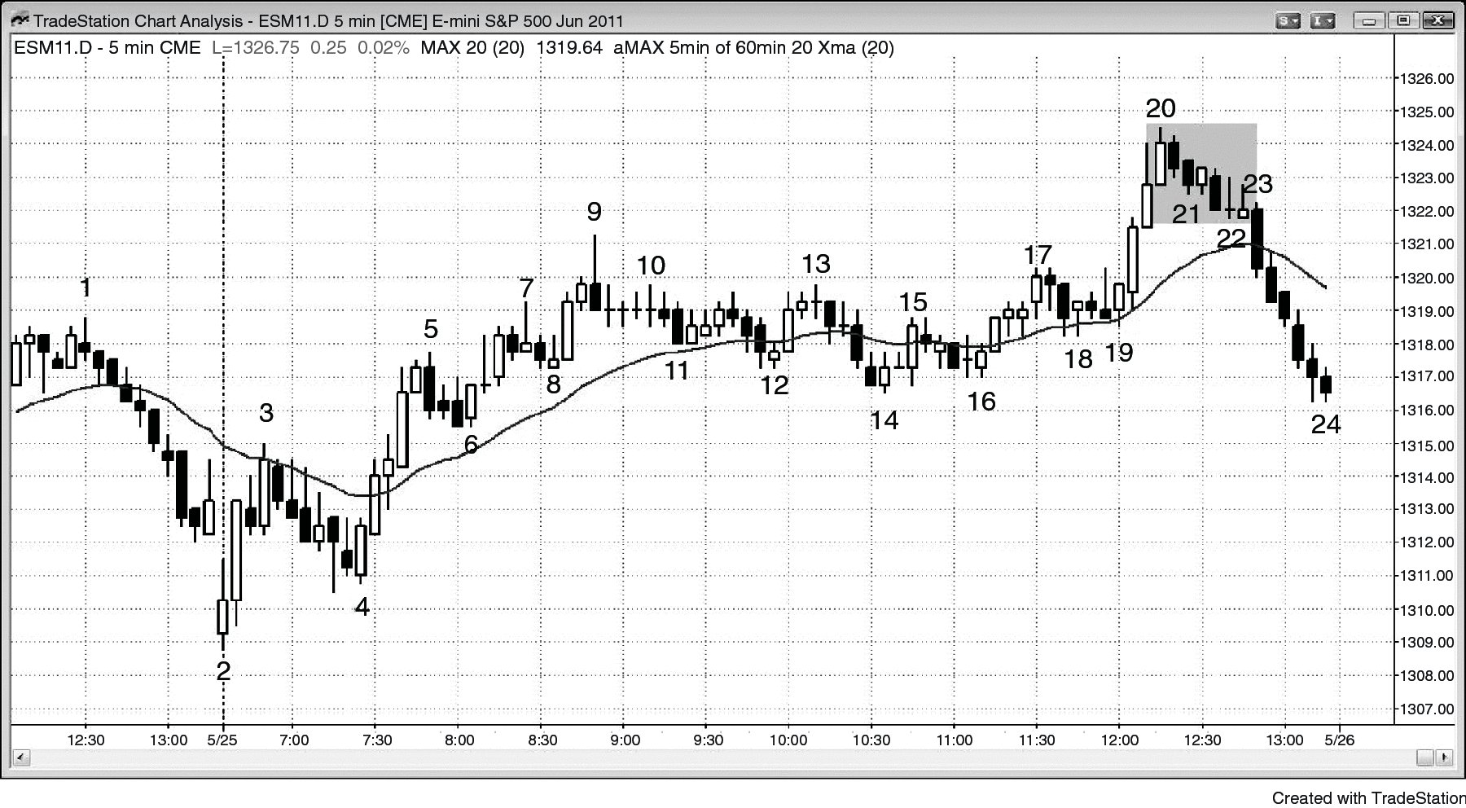
FIGURE 7.6 Bear Breakout of a Bull Final Flag

Slide 7
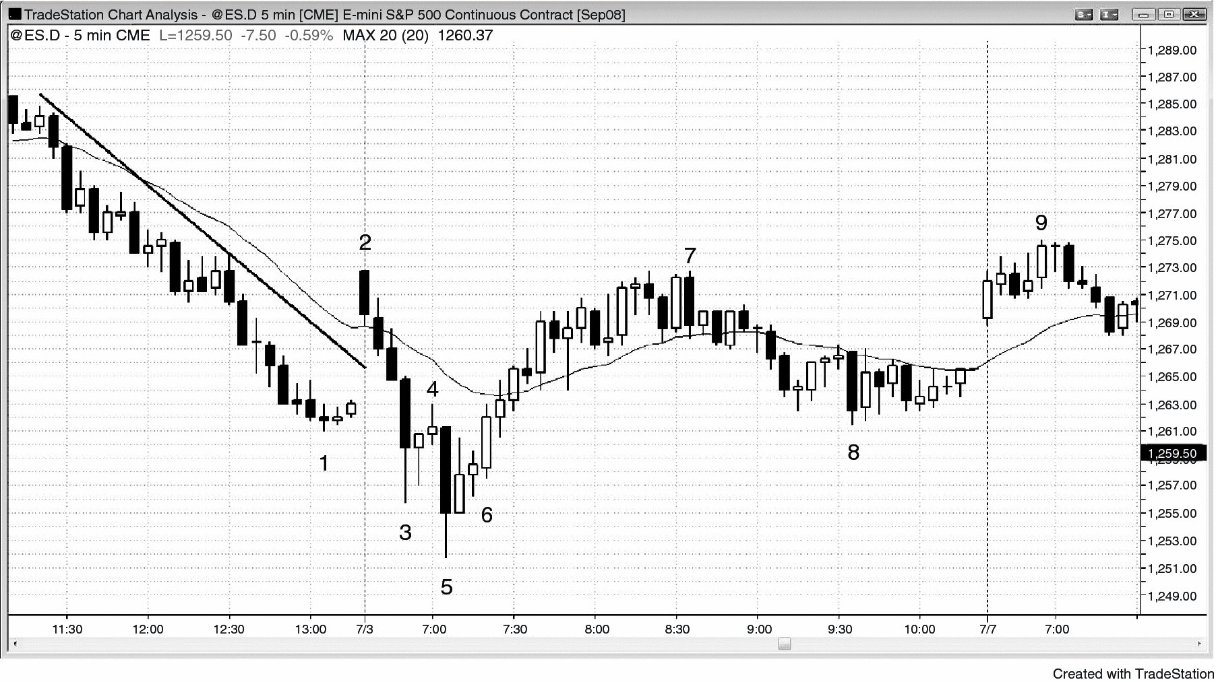
FIGURE 7.7 Small Final Flag and Big Reversal

Slide 8
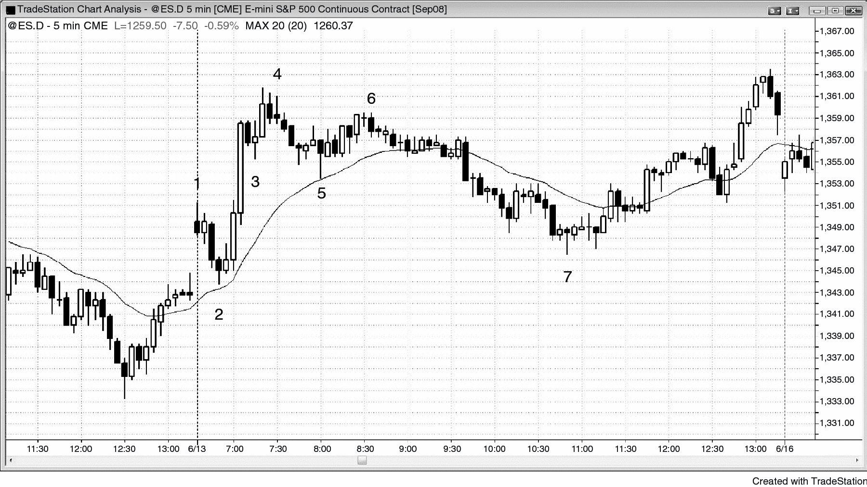
FIGURE 7.8 Two-Bar Final Flag

Slide 9
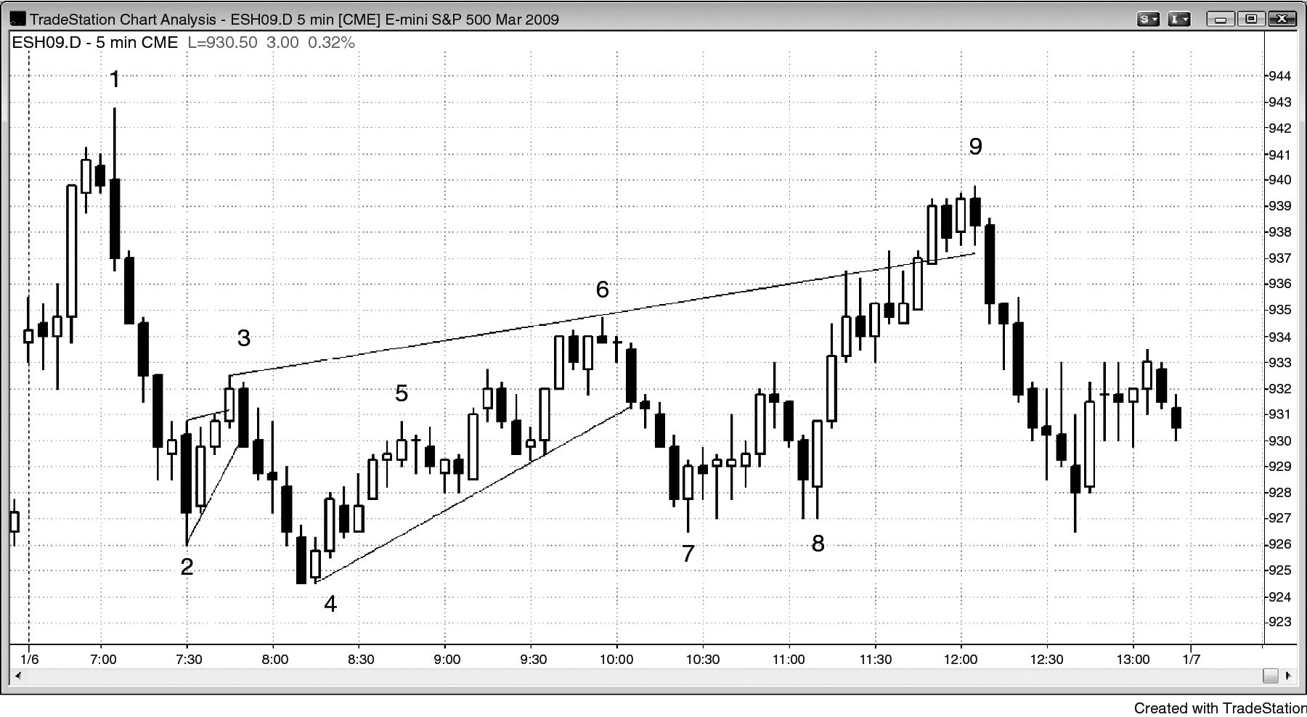
FIGURE 7.9 Small Final Flags Commonly Evolve into Larger Final Flags

Slide 10
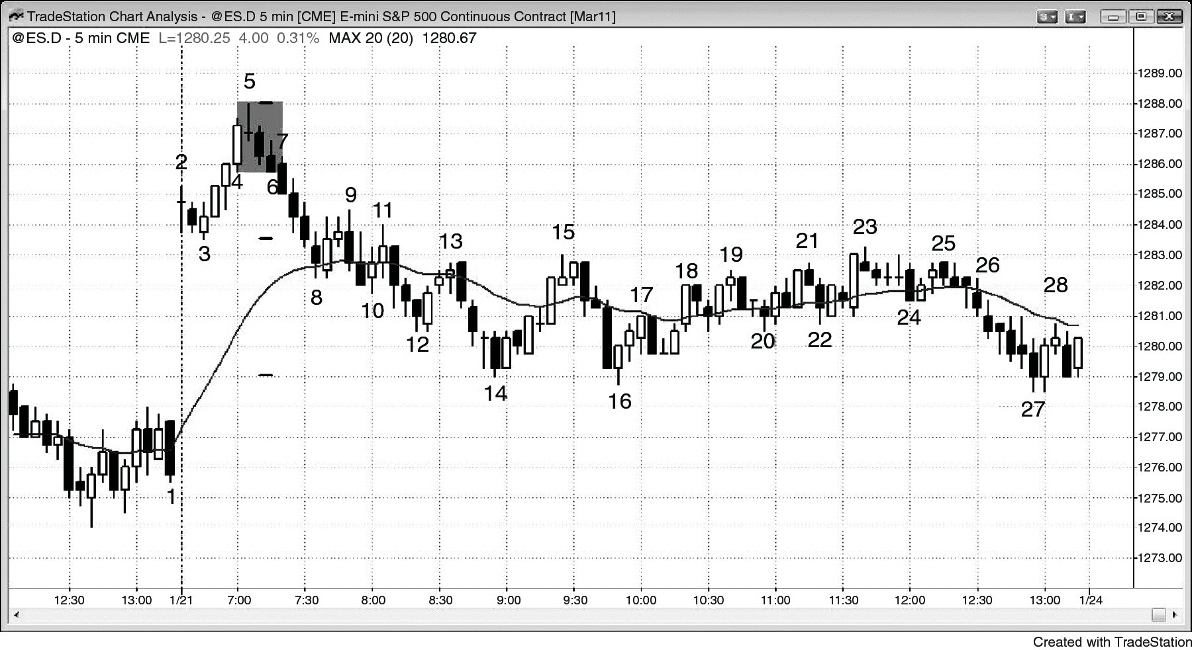
FIGURE 7.10 Final Flags Do Not Have to Break Out in the With-Trend Direction

Slide 11
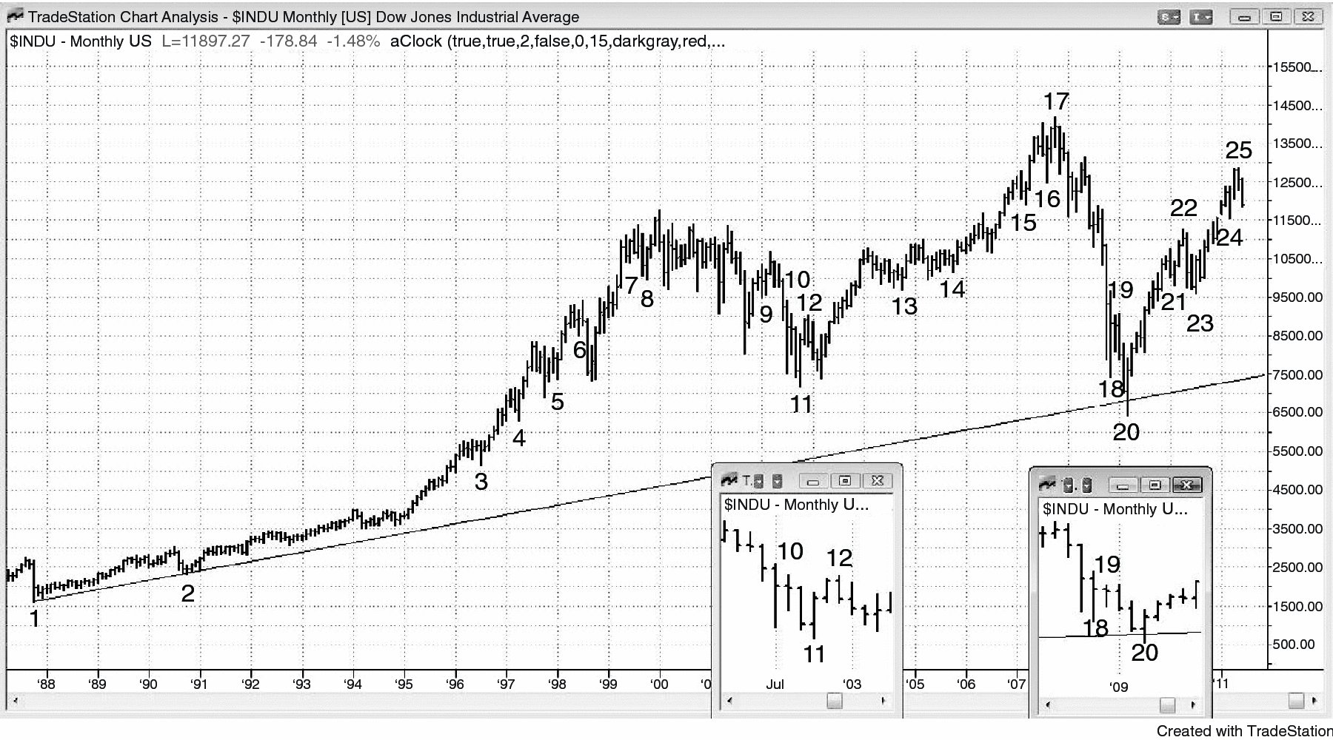
FIGURE 7.11 Small Final Flags after Climaxes

